Slide 1
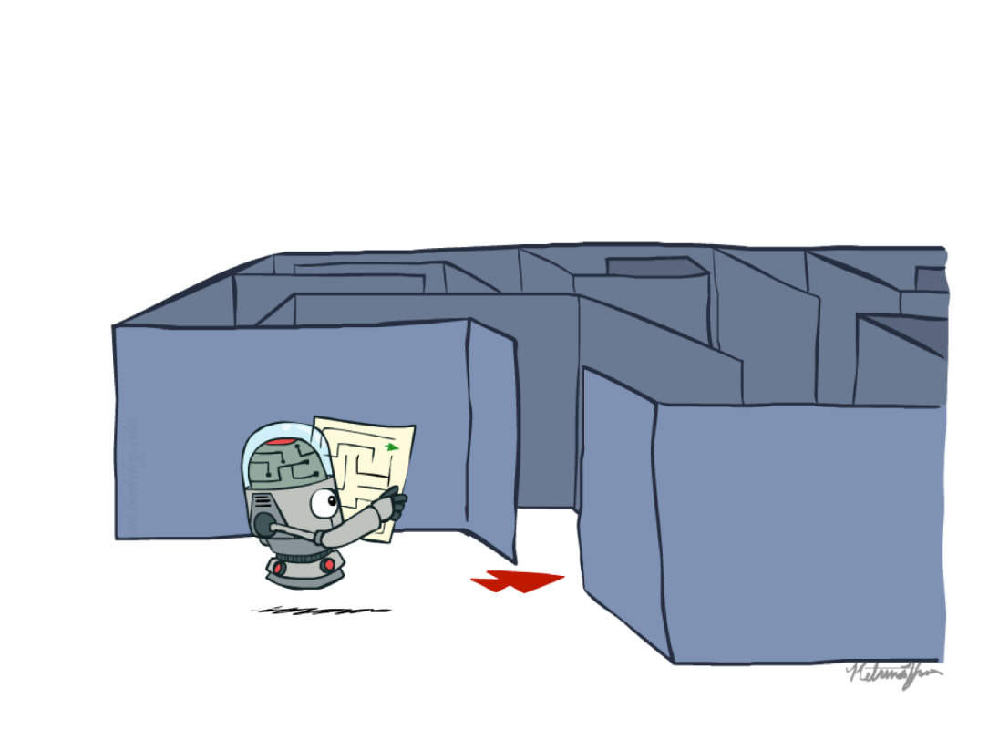
Problem Solving Using Search
Introduction to State Space Search
Slide credits: AI BERKELEY

Slide 2
Previous Lecture
Intelligent Agent
Performance measure
Different types of Environments
Agent types
  Simple reflex agents
  Reflex agents with state/model
  Goal-based agents
  Utility-based agents

Slide 3
Problem Solving
How does an agent actually decide what sequence of actions to take to reach a goal?”
Current State → ??? → Goal State
The “???” part is called SEARCH.

Slide 4

Introduction
Suppose an agent can execute several actions immediately in a given state
It doesn’t know the utility of these actions
Then, for each action, it can execute a sequence of actions until it reaches the goal
The immediate action which has the best sequence (according to the performance measure) is then the solution
Finding this sequence of actions is called search, and the agent which does this is called the problem-solver.
Its possible that some sequence might fail, e.g., getting stuck in an infinite loop, or unable to find the goal at all.

Slide 5
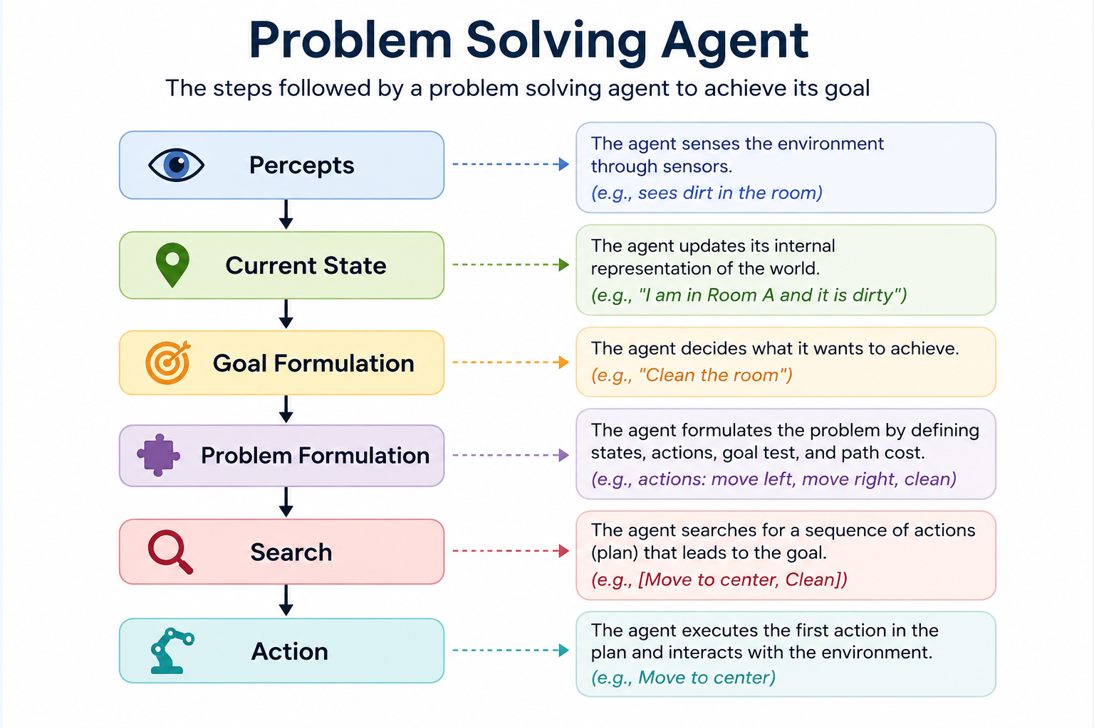

Slide 6
Problem-Solving Agent
Problem solving agent:
  Is goal-based
  Does not know immediately what to do
  Tries different sequences of actions
  Picks the sequence that reaches the goal
Many problems can be represented as a set of states and a set of rules of how one state is transformed to another.

Slide 7
Examples
Getting from home to UCP
  START: home location
  GOAL: UCP FIT Department.
  OPERATORS: move one block, turn
Loading a moving truck
  START: apartment full of boxes and furniture
  GOAL: empty apartment, all boxes and furniture in the truck
  OPERATORS: select item, carry item from apartment to truck, load item
Getting settled
  START: items randomly distributed over the place
  GOAL: satisfactory arrangement of items
  OPERATORS: select item, move item

Slide 8
Example Problems
Toy Problems
  vacuum world
    Two rooms A and B, Each room may be clean or dirty. Agent can turn Left, turn right, and clean by suction
  8-puzzle
    8 numbered tiles, one empty space, arrange numbers in order
  8-queens
    Place 8 queens on a chessboard such that no queen attacks another
  vacuum agent
    Multiple rooms, more dirt locations, possibly partially observable
  missionaries and cannibals
    3 missionaries and 3 cannibals must cross a river.
    Rules:
      Boat holds 2 people max.
      Cannibals can’t outnumber missionaries on either side.
    Goal: Move everyone safely to the other side

Slide 9
Example Problems
Real-world Problems
  route finding
    Finding shortest path from Lahore to Islamabad.
      GPS Systems, Google Maps
  touring problems
    traveling salesperson
      Visit all cities exactly once and return to start.
      Goal:
      Minimize total distance.
      Used in Delivery optimization, airline planning
  Very Large Scale Integration (VLSI) layout
    Goal:
    Place components efficiently:
    Minimize wire length
    Reduce delay
    Used in processor design, chip manufacturing
  robot navigation
    Robot must move from start to goal:
    Avoid obstacles
    Minimize time or distance
    Used in Self driving cars, drones
  assembly sequencing
    Minimize time
    Optimize efficiency
    Used in car manufacturing

Slide 10
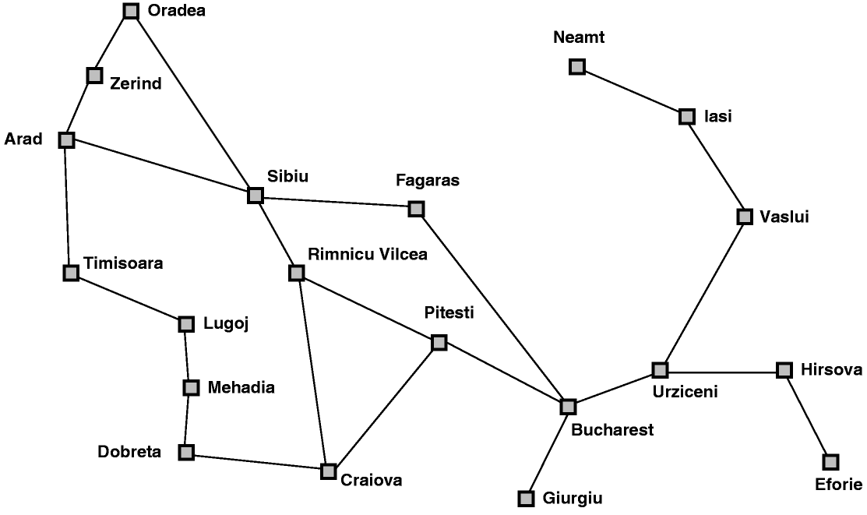
Classical AI Search Problem
Touring Agent Problem (Map Search / Navigation)

Slide 11


Slide 12


Slide 13
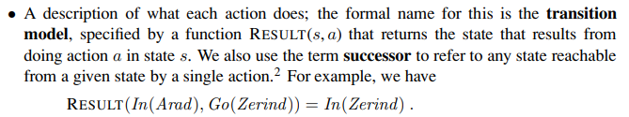

Slide 14


Slide 15
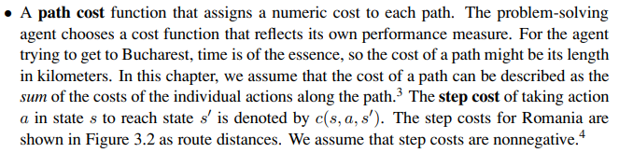

Slide 16
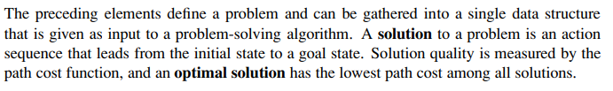

Slide 17
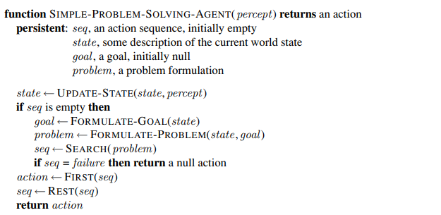
Structure of Problem solving agent

Slide 18
Explanation of problem solving agent
Imagine a robot vacuum:
  Perceives room is dirty (percept)
  Updates state to "room dirty"
  Formulates goal "clean room"
  Creates problem (current location, actions: move, clean)
  Searches for action sequence (e.g., [move to center, clean])
  Executes first action (move to center)

Slide 19
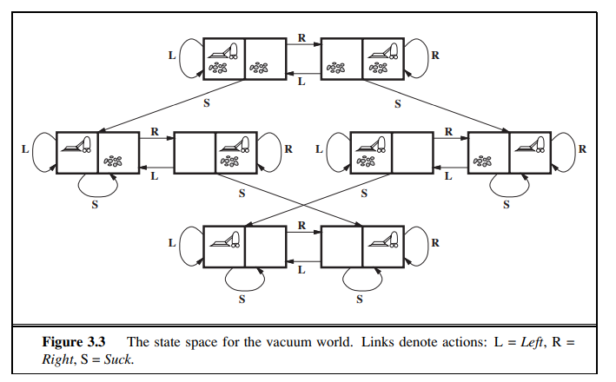
Toy Example-1

Slide 20
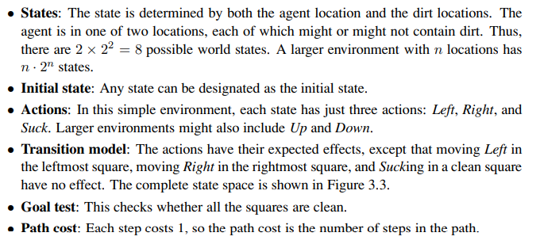

Slide 21
Classical AI Search Problem
8-Puzzle
2
1
3
1
2
3
4
7
6
4
5
6
5
8
7
8

Slide 22
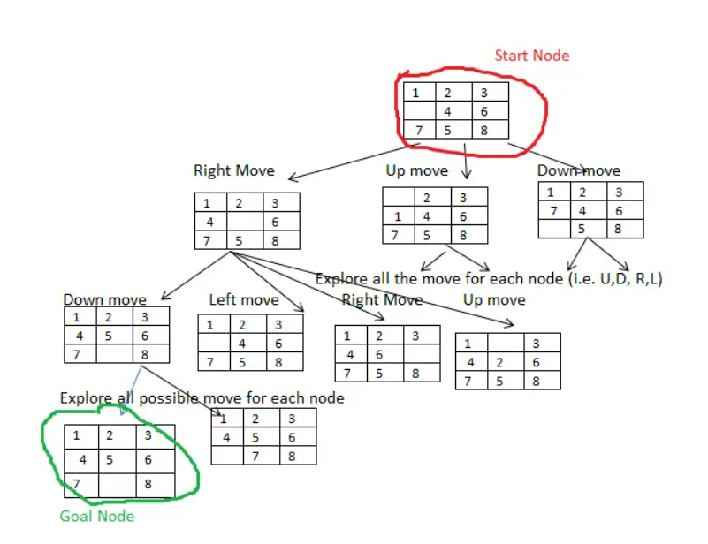

Slide 23
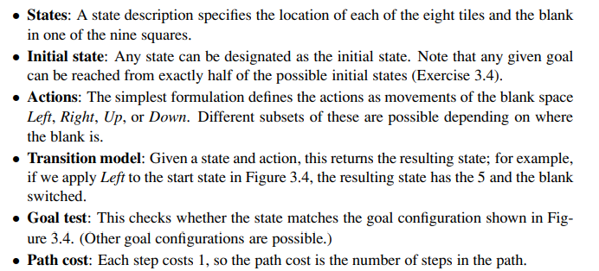

Slide 24
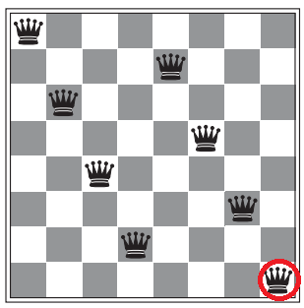
8 Queen Problem
In chess, a queen can move:
  Horizontally (row)
  Vertically (column)
  Diagonally (both directions)
So two queens are attacking each other if they are placed:
  In the same row
  In the same column
  On the same diagonal

Slide 25
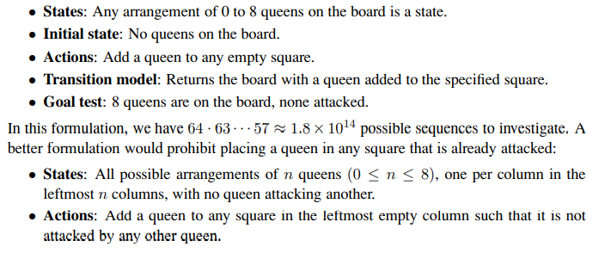

Slide 26
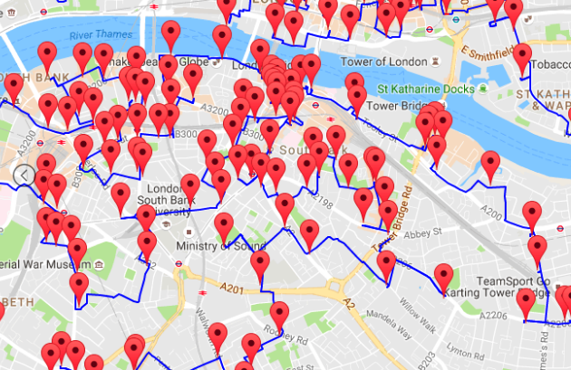
Classical AI Search Problem
Travelling Salesperson Problem (TSP)
  Suppose a salesman has five cities to visit and then must return home.
  The goal of the problem is to find the shortest path for salesman to travel, visiting each city, and then returning to the starting city.

Slide 27
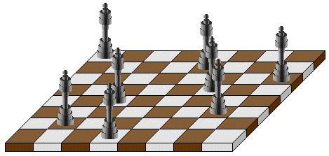
Classical AI Search Problem
N-Queens
  Problem of placing n chess queens on an n×n chessboard so that no two queens attack each other
  A solution requires that no two queens share the same row, column, or diagonal

Slide 28
Classic AI Search Problems
5-Queens:
1
2
3
4
5
1
2
3
4
5

Slide 29
Classic AI Search Problems
5-Queens:
1
2
3
4
5
1
2
3
4
5

Slide 30
Classic AI Search Problems
5-Queens:
1
2
3
4
5
1
2
3
4
5

Slide 31
Classic AI Search Problems
5-Queens:
1
2
3
4
5
1
2
3
4
5

Slide 32
Classic AI Search Problems
5-Queens:
1
2
3
4
5
1
2
3
4
5

Slide 33
Classic AI Search Problems
5-Queens:
1
2
3
4
5
1
2
Solution !!
No Queen is under Attack
3
4
5

Slide 34
River Crossing Problem
A farmer wishes to carry a wolf, a goat and corn across a river, from the south to the north shore.
  The farmer has a small rowing boat.
  The boat can only carry at most the farmer and one other item.
  If left unattended the wolf will eat the goat and the goat will eat the corn.
How can the farmer safely transport the wolf, the goat and the corn to the opposite shore?

Slide 35



Missionaries and cannibals
Three missionaries and three cannibals are on the left bank of a river.
There is one boat which can hold one or two people.
Find a way to get everyone to the right bank, without ever leaving a group of missionaries in one place outnumbered by cannibals in that place.
Initial State
Goal State

Slide 36

Problem Solving by Searching
Problem Formulation

Slide 37
Search in AI
Search in Data Structures
  You’re given an existent tree.
  You search it in different orders.
  It resides in memory.
Search in Artificial Intelligence
  The tree does not exist.
  You have to generate it as you go.
  For realistic problems, it does not fit in memory.

Slide 38
Problem Formulation(defining problem in proper way)
A Problem Space consists of
The current state of the world (initial state)
A description of the actions we can take to transform one state of the world into another (operators or successor function).
A description of the desired state of the world (goal state), this could be implicit or explicit.
A solution consists of the goal state, or a path to the goal state.

Slide 39
Problem Formulation
Initial state
Actions (operators, successor functions)
State space
Path
Goal test
Solution
Path cost
Total cost

Slide 40
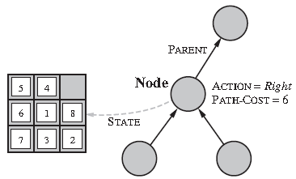
Representation of a Search/State Space
A convenient way of representing search spaces is as a graph
  States are nodes
  Actions are edges
  Initial state is root
  Solution is path from root to goal node
  Edges sometimes have associated costs
  States resulting from operator are children

Slide 41







State Space Representation
A search problem consists of:
  A state space
  A successor function
  (with actions, costs)
  A start state and a goal test
A solution is a sequence of actions (a plan) which transforms the start state to a goal state
“N”, 1.0
“E”, 1.0
Notes:
Often comes back on exams
Goal test – sometimes more than one state that satisfies having achieved the goal, for example, “eat all the dots”
Abstraction

Slide 42
State Space Graphs
State space graph: A mathematical representation of a search problem
  Nodes are (abstracted) world configurations
  Arcs represent successors (action results)
  The goal test is a set of goal nodes (maybe only one)
In a state space graph, each state occurs only once!
We can rarely build this full graph in memory (it’s too big), but it’s a useful idea
a
G
b
c
d
e
f
S
h
p
q
r
Tiny search graph for a tiny search problem

Slide 43
Search Trees
This is now / start
“N”, 1.0
“E”, 1.0
Possible futures
A search tree:
  A “what if” tree of plans and their outcomes
  The start state is the root node
  Children correspond to successors
  Nodes show states, but correspond to PLANS that achieve those states
  For most problems, we can never actually build the whole tree
Notes:
Different plans that achieve the same state, will be different nodes in the tree.

Slide 44
State Space Graphs vs. Search Trees
State Space Graph
Each NODE in the search tree is an entire PATH in the state space graph.
Search Tree
S
a
G
d
e
p
b
c
q
b
c
e
h
r
d
e
f
a
a
h
r
p
q
f
S
h
We construct both on demand – and we construct as little as possible.
p
q
f
q
c
G
p
q
r
q
c
G
a
a

Slide 45
Approach
Start with a frontier that contains the initial state.
Repeat:
  If the frontier is empty, then no solution.
  Remove a node from the frontier.
  If node contains goal state, return the solution.
  Expand node, add resulting nodes to the frontier.

Slide 46
Quiz: State Space Graphs vs. Search Trees
Consider this 4-state graph:
How big is its search tree (from S)?
a
S
G
b

Slide 47

Quiz: State Space Graphs vs. Search Trees
Consider this 4-state graph:
How big is its search tree (from S)?
a
s
a
b
S
G
b
G
a
G
b
a
G
b
G
…
…
Important: Lots of repeated structure in the search tree!

Slide 48
Revised Approach
Start with a frontier that contains the initial state.
Start with an empty explored set.
Repeat:
  If the frontier is empty, then no solution.
  Remove a node from the frontier.
  If node contains goal state, return the solution.
  Add the node to the explored set.
  Expand node, add resulting nodes to the frontier if they aren't already in the frontier or the explored set.

Slide 49
Searching with a Search Tree
Search:
(1) Expand out potential plans (tree nodes)
(2) Maintain fringe (peripheral) partial plans under consideration.
(3) Try to expand as few tree nodes as possible

Slide 50
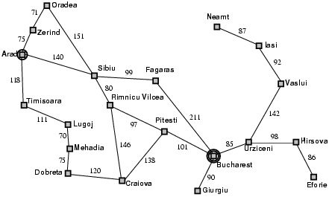
Example: Romania

Slide 51
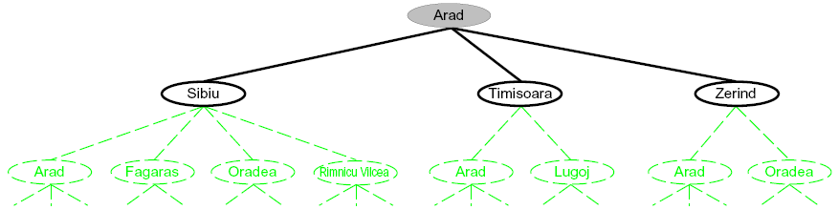
Searching with a Search Tree
Search:
  Expand out potential plans (tree nodes)
  Maintain a fringe (The collection of generated nodes that have not yet been expanded) of partial plans under consideration
  Try to expand as few tree nodes as possible

Slide 52
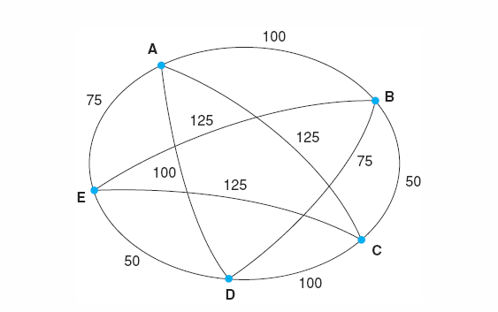
Problem Formulation: TSP
Travelling Salesperson Problem (TSP)
  Suppose a salesman has four cities to visit and then must return home.
  The goal of the problem is to find the shortest path for salesman to travel, visiting each city, and then returning to the starting city.

Slide 53
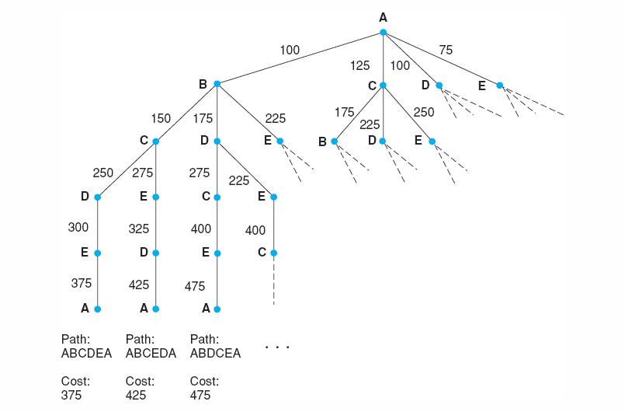
Search for the travelling salesperson problem. Each arc is marked with the total weight of all paths from the start node (A) to its endpoint.
Luger: Artificial Intelligence, 6th edition. © Pearson Education Limited, 2009

Slide 54
Problem Formulation: 8-Puzzle Problem
Initial State
Operators
Goal State
2
1
3
Slide blank square left.
Slide blank square right.
….
1
2
3
4
7
6
4
5
6
5
8
7
8

Slide 55
Problem Formulation: 8-Puzzle Problem
Representing states:
For the 8-puzzle
3 by 3 array
  5, 6, 7
  8, 4, BLANK
  3, 1, 2
A vector of length nine
  5, 6, 7, 8, 4, BLANK, 3, 1, 2
A list of facts
  Upper_left = 5
  Upper_middle = 6
  Upper_right = 7
  Middle_left = 8
5
6
7
8
4
3
1
2

Slide 56
Problem Formulation: 8-Puzzle Problem
Specifying operators
  There are often many ways to specify the operators, some will be much easier to implement...
Move 1 left
Move 1 right
Move 1 up
Move 1 down
Move 2 left
Move 2 right
Move 2 up
Move 2 down
Move 3 left
Move 3 right
Move 3 up
Move 3 down
Move 4 left
…
5
6
7
Move Blank left
Move Blank right
Move Blank up
Move Blank down
8
4
3
1
2

Slide 57
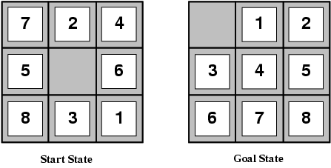
Problem Formulation: 8-Puzzle Problem
states locations of tiles
actions move left, right, up, down
goal test goal state (given)
path cost 1 per move

Slide 58
Problem Formulation: 8-Puzzle Problem
1
2
3
1
2
3
Operators: slide blank up, slide blank down, slide blank left, slide blank right
Solution: swap-down, swap-left, swap-up, swap-right, swap-down
Path cost: 5 steps to reach the goal
4
8
4
5
6
7
6
5
7
8
Initial state
Goal state
1
2
3
1
2
3
1
2
3
1
2
3
1
2
3
1
2
3
4
8
4
8
5
4
8
5
4
5
4
5
4
5
6
7
6
5
7
6
7
6
7
8
6
7
8
6
7
8

Slide 59
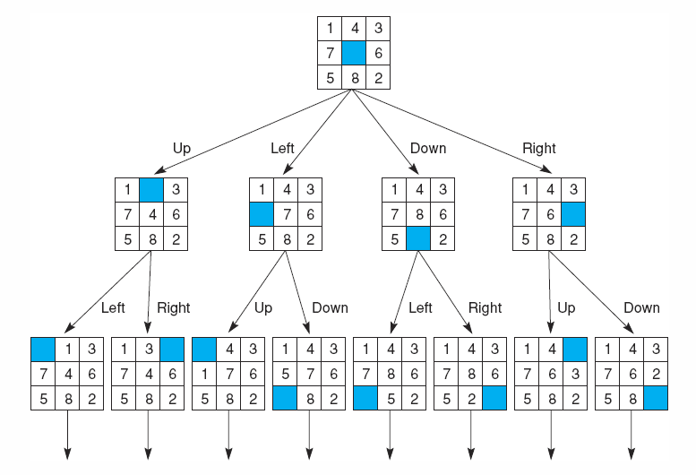
State space of the 8-puzzle generated by “move blank” operations
Notes:
Insert fig 3.8

Slide 60
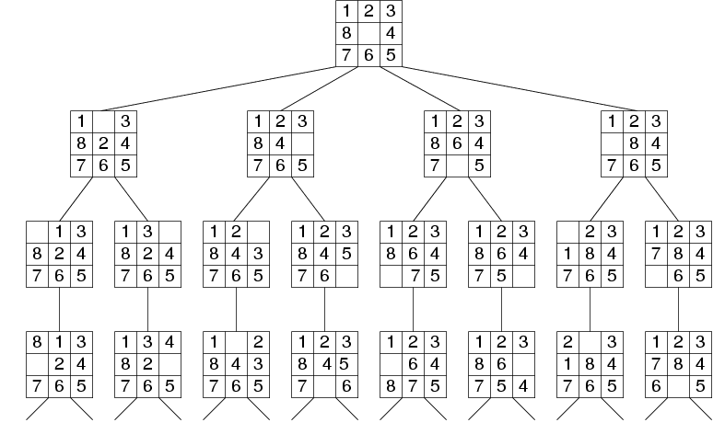
Fragment of 8-Puzzle Problem Space

Slide 61

Problem Formulation:
Missionaries and Cannibals
Three missionaries and three cannibals are on the left bank of a river.
There is one boat which can hold one or two people.
Find a way to get everyone to the right bank, without ever leaving a group of missionaries in one place outnumbered by cannibals in that place.

Slide 62
Missionaries and cannibals
States: three numbers (i, j, k) representing the number of missionaries, cannibals, and boats on the left bank of the river.
Initial state: (3, 3, 1)
Operators: take one missionary, one cannibal, two missionaries, two cannibals, one missionary and one cannibal across the river in a given direction
Goal Test: reached state (0, 0, 0)?
Path Cost: Number of crossings.

Slide 63
Formalization of the M&C Problem
State space: triple (x,y,z), where x,y, and z represent the number of missionaries, cannibals and boats currently on the original bank.
Initial State: (3,3,1)
Successor function: From each state, either bring one missionary, one cannibal, two missionaries, two cannibals, or one of each type to the other bank.
Note: Not all states are attainable (e.g., (0,0,1)), and some are illegal.
Goal State: (0,0,0)
Path Costs: 1 unit per crossing

Slide 64
Missionaries and Cannibals
Solution = the sequence of actions within the path :
[(3,3,1)→ (2,2,0)→(3,2,1) →(3,0,0) →(3,1,1) →(1,1,0) →(2,2,1) →(0,2,0) →(0,3,1) →(0,1,0) → (0,2,1) →(0,0,0)]
Cost = 11 crossings

Slide 65
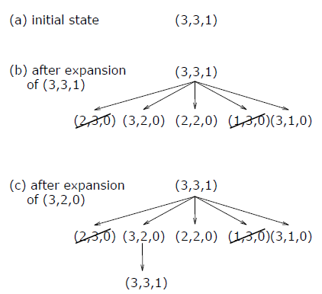
Missionaries and Cannibals
From the initial state, produce all successive states step by step search tree.

Slide 66
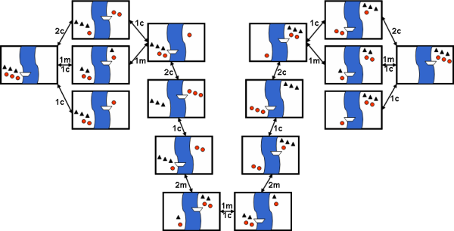
Missionaries and Cannibals
Search-space for the Missionaries and Cannibals problem

Slide 67
The River Problem
A farmer wishes to carry a wolf, a duck and corn across a river, from the south to the north shore. The farmer has a small rowing boat. The boat can only carry at most the farmer and one other item.
If left unattended the wolf will eat the duck and the duck will eat the corn.
How can the farmer safely transport the wolf, the duck and the corn to the opposite shore?
Farmer, Wolf,
Duck and Corn
River
River
boat
boat
Farmer, Wolf,
Duck and Corn

Slide 68
The River Problem
The River Problem:
F=Farmer W=Wolf G=Goat C=Corn /=River
How can the farmer safely transport the wolf, the duck and the corn to the opposite shore?
-/FWCD
FWGD/-

Slide 69
The River Problem
Problem formulation:
  State representation: location of farmer and items in both sides of river
  [items in South shore / items in North shore] : (FWDC/-, FD/WC, C/FWD …)
  Initial State: farmer, wolf, duck and corn in the south shore FWDC/-
  Goal State: farmer, duck and corn in the north shore -/FWDC
  Operators: the farmer takes in the boat at most one item from one side to the other side
  (F-Takes-W, F-Takes-D, F-Takes-C, F-Takes-Self [himself only])
  Path cost: the number of crossings

Slide 70
The River Problem
Problem solution: (path Cost = 7)
  While there are other possibilities here is one 7 step solution to the river problem
F
D
D
F
W
D
F-Takes-D
F-Takes-F
F-Takes-W
F
W
D
C
W
C
F
W
C
C
Initial State
WC/FD
FWC/D
C/FWD
F-Takes-D
F
W
D
C
W
C
F
W
C
W
F-Takes-D
F-Takes-F
F-Takes-C
F
D
D
F
D
C
Goal State
FD/WC
D/FWC
FDC/W

Slide 71
Summary
Search: process of constructing sequences of actions that achieve a goal given a problem.
It is assumed that the environment is observable, deterministic, static and completely known.
Goal formulation is the first step in solving problems by searching. It facilitates problem formulation.
Formulating a problem requires specifying five components:
  State representation,
  Initial state,
  Goal state,
  Operators (actions), and
  Path cost function.

Slide 72
Search Strategies
Several general-purpose search algorithms that can be used to solve these problems.
Uninformed search algorithms
  algorithms that are given no information about the problem other than its definition
  Although some of these algorithms can solve any solvable problem, none of them can do so efficiently
Informed search algorithms
  can do quite well given some guidance on where to look for solutions

Slide 73
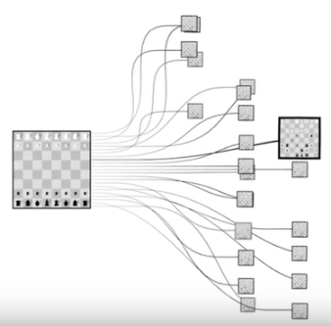

Slide 74


Slide 75
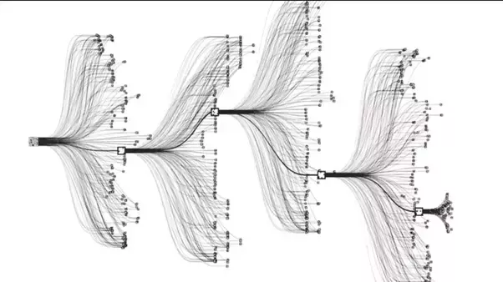

Slide 76
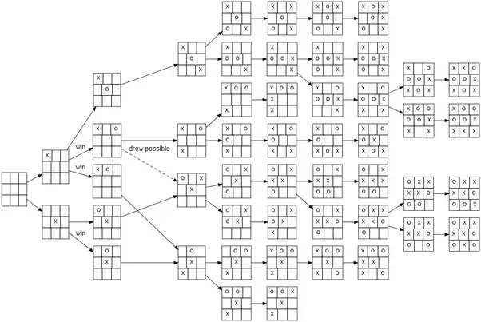

Slide 77
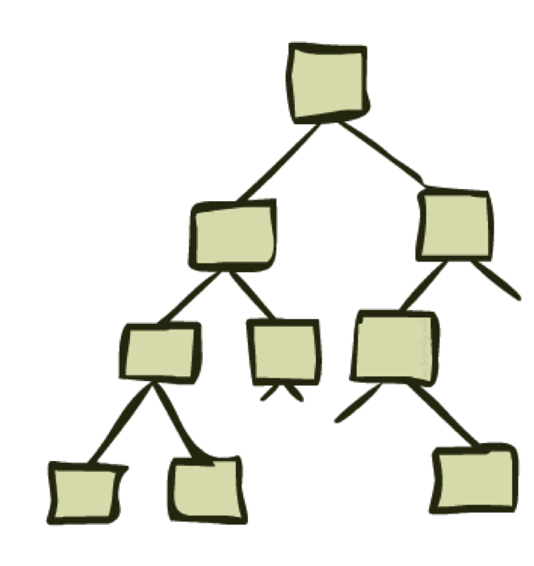
Uninformed Search-II
Depth First Search and its Variants

Slide 78
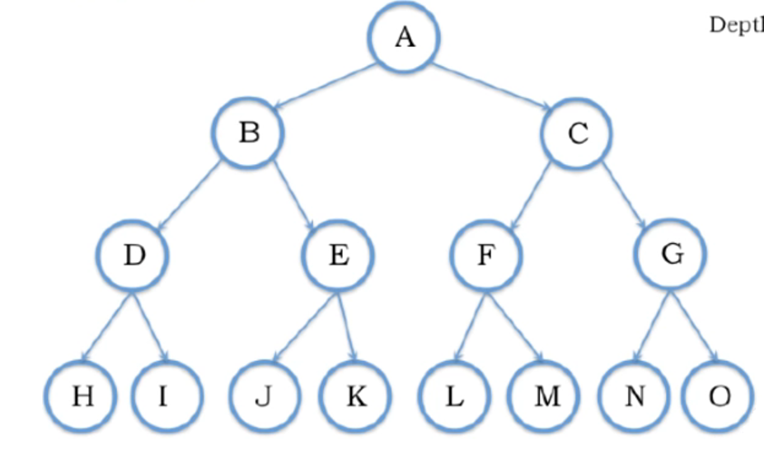

Depth First Search (DFS)

Slide 79
Depth First Search (DFS)
Elements pushed
on stack
Stack
A
Elements Popped From Stack:

Slide 80
Depth First Search (DFS)
Elements pushed
on stack
Stack
C
B
A
Elements Popped From Stack:
A →

Slide 81
Depth First Search (DFS)
Elements pushed
on stack
Stack
G
F
C
B
A
Elements Popped From Stack:
A → C →

Slide 82
Depth First Search (DFS)
Elements pushed
on stack
Stack
O
N
G
F
C
B
A
Elements Popped From Stack:
A → C → G

Slide 83
Depth First Search (DFS)
Elements pushed
on stack
Stack
O
N
G
F
C
B
A
Elements Popped From Stack:
A → C → G → O

Slide 84
Depth First Search (DFS)
Elements pushed
on stack
Stack
O
N
G
F
C
B
A
Elements Popped From Stack:
A → C → G → O → N

Slide 85
Depth First Search (DFS)
Elements pushed
on stack
Stack
M
L
O
N
G
F
C
B
A
Elements Popped From Stack:
A → C → G → O → N → F

Slide 86
Depth First Search (DFS)
Elements pushed
on stack
Stack
M
L
O
N
G
F
C
B
A
Elements Popped From Stack:
A → C → G → O → N → F → M

Slide 87
Depth First Search (DFS)
Elements pushed
on stack
Stack
M
L
O
N
G
F
C
B
A
Elements Popped From Stack:
A → C → G → O → N → F → M → L

Slide 88
Depth First Search (DFS)
Elements pushed
on stack
Stack
E
D
M
L
O
N
G
F
C
B
A
Elements Popped From Stack:
A → C → G → O → N → F → M → B

Slide 89
Depth First Search (DFS)
Elements pushed
on stack
Stack
K
J
E
D
M
L
O
N
G
F
C
B
A
Elements Popped From Stack:
A → C → G → O → N → F → M → B → E

Slide 90
Depth First Search (DFS)
Elements pushed
on stack
Stack
K
J
E
D
M
L
O
N
G
F
C
B
A
Elements Popped From Stack:
A → C → G → O → N → F → M → B → E → K

Slide 91
Depth First Search (DFS)
Elements pushed
on stack
Stack
K
J
E
D
M
L
O
N
G
F
C
B
A
Elements Popped From Stack:
A → C → G → O → N → F → M → B → E → K → J

Slide 92
Depth First Search (DFS)
Elements pushed
on stack
Stack
I
H
K
J
E
D
M
L
O
N
G
F
C
B
A
Elements Popped From Stack:
A → C → G → O → N → F → M → B → E → K → J →D

Slide 93
Depth First Search (DFS)
Elements pushed
on stack
Stack
I
H
K
J
E
D
M
L
O
N
G
F
C
B
A
Elements Popped From Stack:
A → C → G → O → N → F → M → B → E → K → J → D → I

Slide 94
Depth First Search (DFS)
Elements pushed
on stack
Stack
I
H
K
J
E
D
M
L
O
N
G
F
C
B
A
Elements Popped From Stack:
A → C → G → O → N → F → M → B → E → K → J → D → I → H

Slide 95
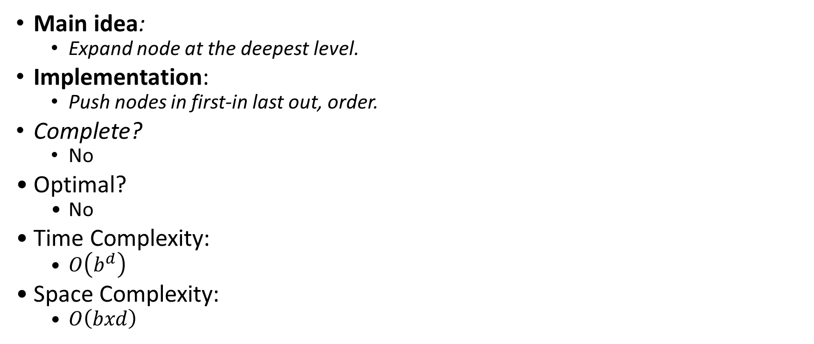
Depth First Search (DFS)
Main idea:
  Expand node at the deepest level.
Implementation:
  Push nodes in first-in last out, order.
Complete?
  No
Optimal?
  No
Time Complexity:
  $O\left(b^{d}\right)$
Space Complexity:
  $O\left(bxd\right)$

Slide 96
Depth-Limited Search (DLS)
DFS with a depth bound
  Searching is not permitted beyond the depth bound.
Works well if we know what is the depth of the solution.
If the solution is beneath the depth bound, the search cannot find the goal (hence this search algorithm is not complete).

Slide 97
Depth Limited Search (DLS)

Slide 98
Depth Limited Search (DLS)
Elements pushed
on stack
Stack
A
Depth Limit = 2
Elements Popped From Stack:

Slide 99
Depth Limited Search (DLS)
Elements pushed
on stack
Stack
C
B
A
Depth Limit = 2
Elements Popped From Stack:
A →

Slide 100
Depth Limited Search (DLS)
Elements pushed
on stack
Stack
G
F
C
B
A
Depth Limit = 2
Elements Popped From Stack:
A → C →

Slide 101
Depth Limited Search (DLS)
Elements pushed
on stack
Stack
G
F
C
B
A
Depth Limit = 2
Elements Popped From Stack:
A → C → G

Slide 102
Depth Limited Search (DLS)
Elements pushed
on stack
Stack
G
F
C
B
A
Depth Limit = 2
Elements Popped From Stack:
A → C → G →F

Slide 103
Depth Limited Search (DLS)
Elements pushed
on stack
Stack
E
D
G
F
C
B
A
Depth Limit = 2
Elements Popped From Stack:
A → C → G → F → B

Slide 104
Depth Limited Search (DLS)
Elements pushed
on stack
Stack
E
D
G
F
C
B
A
Depth Limit = 2
Elements Popped From Stack:
A → C → G → F → B → E

Slide 105
Depth Limited Search (DLS)
Elements pushed
on stack
Stack
E
D
G
F
C
B
A
Depth Limit = 2
Elements Popped From Stack:
A → C → G → F → B → E →D

Slide 106
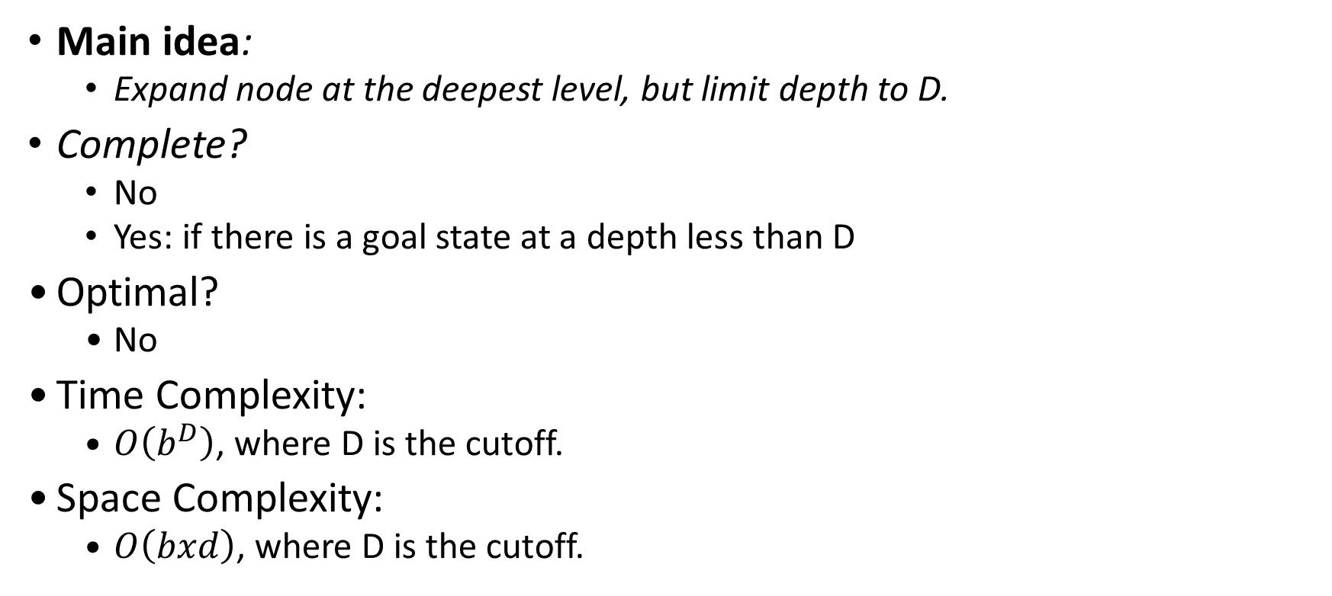
Depth-Limited Search (DLS)
Main idea:
  Expand node at the deepest level, but limit depth to D.
Complete?
  No
  Yes: if there is a goal state at a depth less than D
Optimal?
  No
Time Complexity:
  $O\left(b^{D}\right)$, where D is the cutoff.
Space Complexity:
  $O\left(bxd\right)$, where D is the cutoff.

Slide 107
Depth-Limited Search (DLS)
DFS with a depth bound
  Searching is not permitted beyond the depth bound.
Works well if we know what is the depth of the solution.
If the solution is beneath the depth bound, the search cannot find the goal (hence this search algorithm is not complete).

Slide 108
Iterative Deepening Search
To avoid the infinite depth problem of DFS:
  Only search until depth L
  i.e, don’t expand nodes beyond depth L
  Depth-Limited Search
What if solution is deeper than L?
  Increase depth iteratively
  Iterative Deepening Search
IDS
  Inherits the memory advantage of depth-first search
  Has the completeness property of breadth-first search

Slide 109
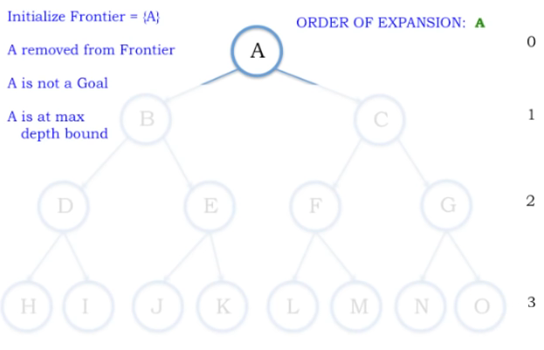
Depth Bound = 0
Elements pushed
on stack
Stack
A

Slide 110
Depth Bound = 0
Elements pushed
on stack
Stack
A

Slide 111
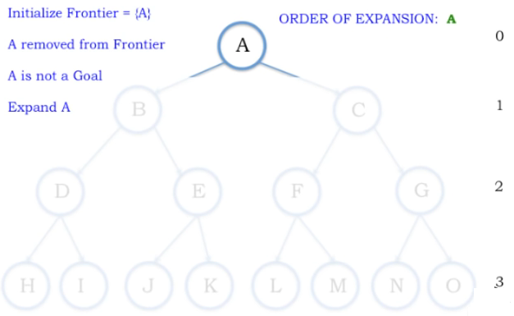
Depth Bound = 1
Elements pushed
on stack
Stack
A

Slide 112
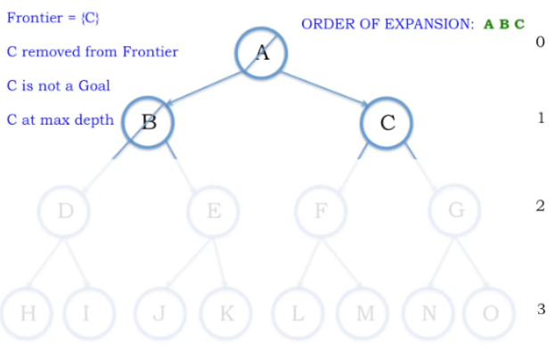
Depth Bound = 1
Elements pushed
on stack
Stack
B
C
A
B
A B
B
B
B

Slide 113
Depth Bound = 1
Elements pushed
on stack
Stack
B
C
A
C
A B C
C
C
C

Slide 114
Depth Bound = 1
Elements pushed
on stack
Stack
B
C
A

Slide 115

Depth Bound = 2
Elements pushed
on stack
Stack
A

Slide 116
Depth Bound = 2
Elements pushed
on stack
Stack
B
C
A

Slide 117
Depth Bound = 2
Elements pushed
on stack
Stack
D
E
B
C
A
B C
A B
B
B
B

Slide 118
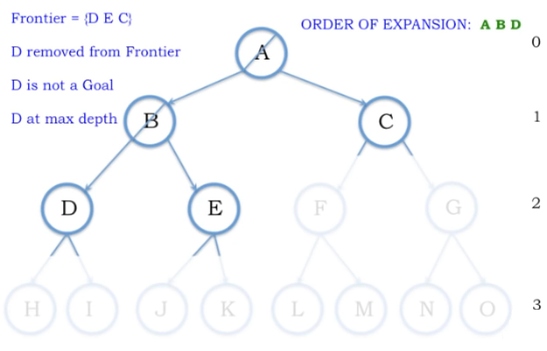
Depth Bound = 2
Elements pushed
on stack
Stack
D
E
B
C
A
D
A B D
D
D
B

Slide 119
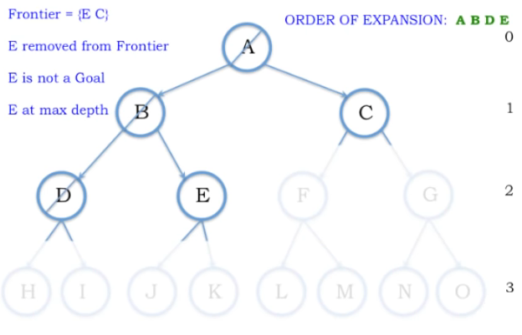
Depth Bound = 2
Elements pushed
on stack
Stack
D
E
B
C
A
E
A B D E

Slide 120
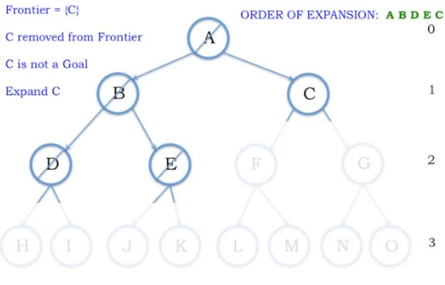
Depth Bound = 2
Elements pushed
on stack
Stack
E
D
B
C
A
A B D E

Slide 121
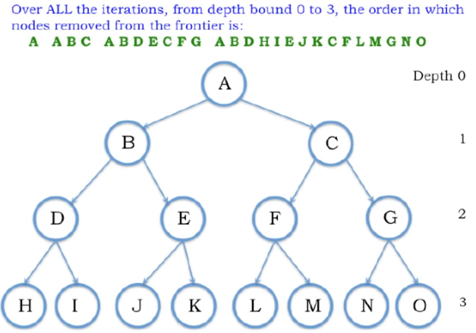
Depth Bound = 3

Slide 122
Iterative Deepening Search
To avoid the infinite depth problem of DFS:
  Only search until depth L
  i.e, don’t expand nodes beyond depth L
  Depth-Limited Search
What if solution is deeper than L?
  Increase depth iteratively
  Iterative Deepening Search
IDS
  Inherits the memory advantage of depth-first search
  Has the completeness property of breadth-first search

Slide 123
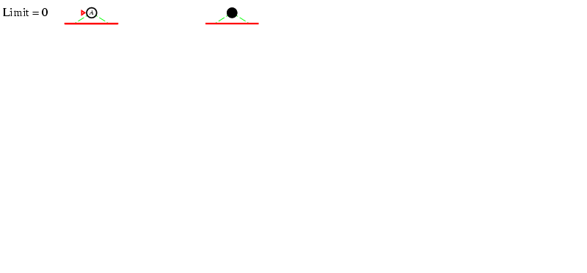
Iterative deepening search l =0
123

Slide 124
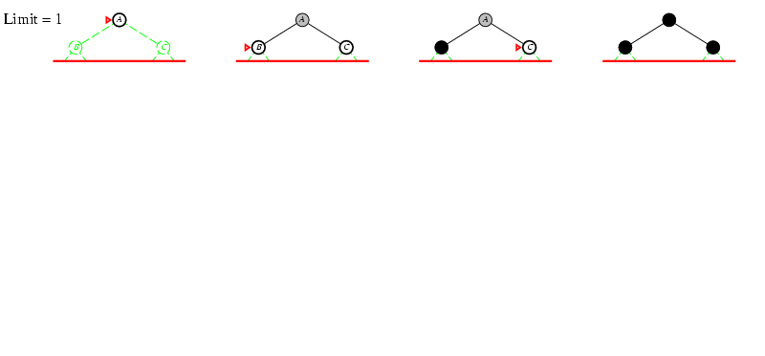
Iterative deepening search l =1
124

Slide 125
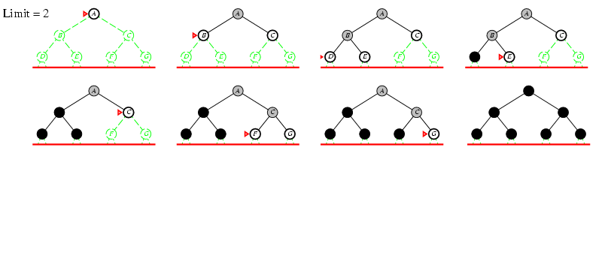
Iterative deepening search l =2
125

Slide 126
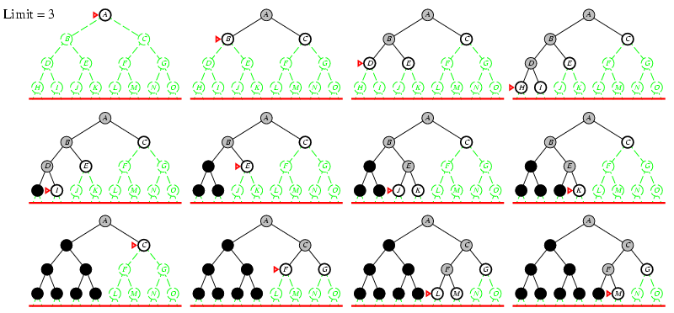
Iterative deepening search l =3
126

Slide 127
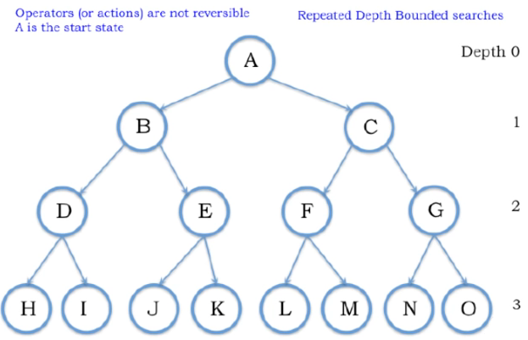

Slide 128
Depth Bound = 0

Slide 129
Depth Bound = 1

Slide 130
Depth Bound = 1

Slide 134
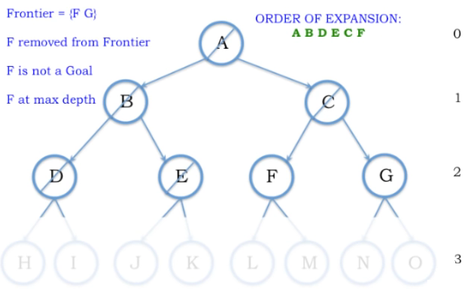

Slide 135
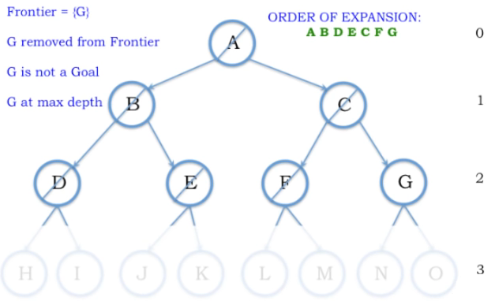
Depth 2

Slide 137
Properties of Iterative Deepening Search
Complete? Yes (in finite spaces)
Time? O(b^{d})
Space? O(bd)
Optimal? Yes, (if step cost = 1 i.e. identical step cost)
137

Slide 138
Example
A
D
B
Do it on notebook
Start Node: A
Goal Node: G
Step Frontier Expand[*] Explored: a set of nodes
F
E
C
G
B
G
E
1 | A | A | {-}
2 | D B | B | {A}
3 | D C | C | {A,B}
4 | D G E | E | {A B C}

Slide 139
Iterative Deepening Search
Idea: get DFS’s space advantage with BFS’s time / shallow-solution advantages
  Run a DFS with depth limit 1. If no solution…
  Run a DFS with depth limit 2. If no solution…
  Run a DFS with depth limit 3. …..
b
…

Slide 140
When to do goal test?
Do Goal-Test when node is popped from queue
  IF you care about finding the optimal path
  AND your search space may have both short expensive and long cheap paths to a goal.
    Guard against a short expensive goal.
    E.g., Uniform Cost search with variable step costs.
Otherwise, do Goal-Test when is node inserted.
  E.g., Breadth-first Search, Depth-first Search, or Uniform Cost search when cost is a non-decreasing function of depth only (which is equivalent to Breadth-first Search).
REASON ABOUT your search space & problem.
  How could I possibly find a non-optimal goal?

Slide 141
When to do Goal-Test? Summary
For DFS, BFS, DLS, and IDS, the goal test is done when the child node is generated.
  These are not optimal searches in the general case.
  BFS and IDS are optimal if cost is a function of depth only; then, optimal goals are also shallowest goals and so will be found first
For GBFS the behavior is the same whether the goal test is done when the node is generated or when it is removed
  h(goal)=0 so any goal will be at the front of the queue anyway.
For UCS and A* the goal test is done when the node is removed from the queue.
This precaution avoids finding a short expensive path before a long cheap path.

Slide 142
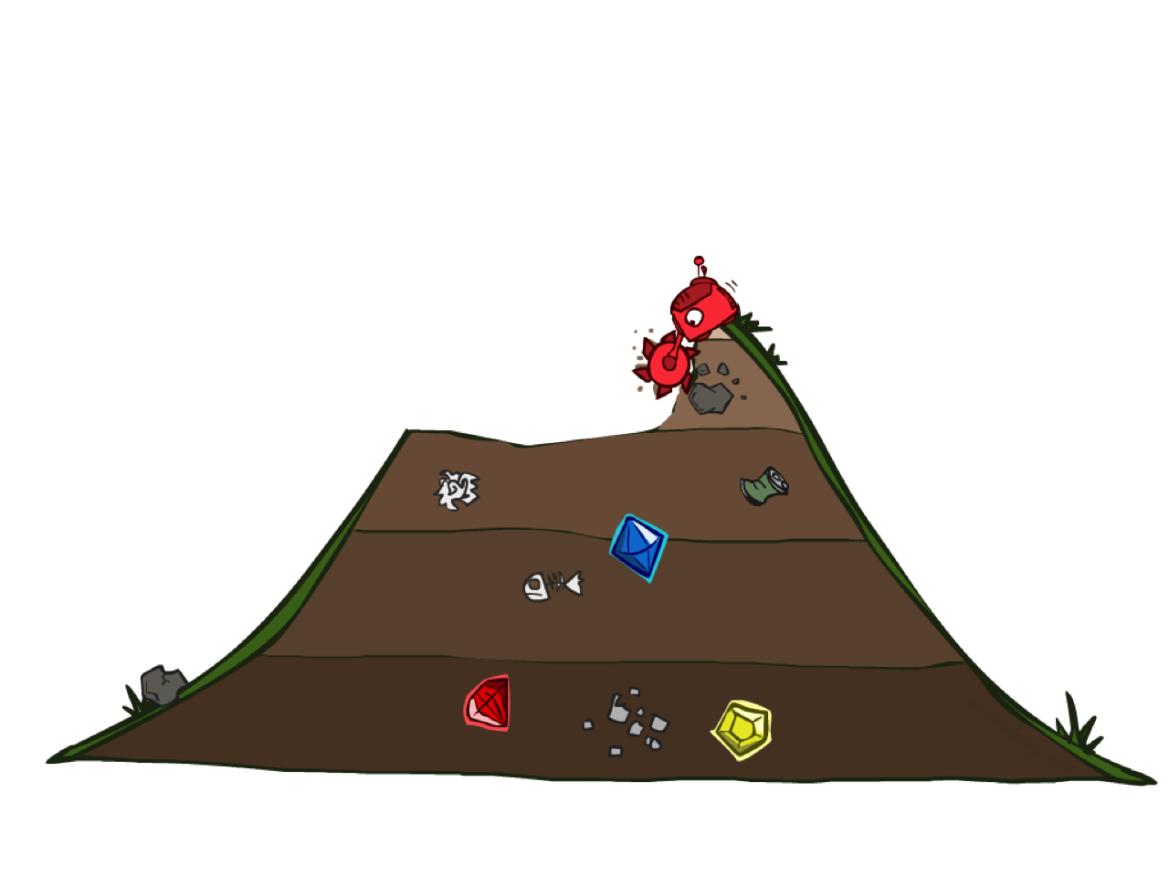
Uniform Cost Search

Slide 143
Cost-Sensitive Search
a
GOAL
2
2
b
c
3
2
1
8
2
e
d
f
3
9
8
2
START
h
1
4
2
p
4
r
15
q
BFS finds the shortest path in terms of number of actions.
It does not find the least-cost path. We will now cover
a similar algorithm which does find the least-cost path.

Slide 144
Uniform Cost Search
Breadth-First Search find the shallowest goal state, but this may not always be the least-cost solution.
Uniform-Cost Search modifies the Breadth-First Search strategy by always expanding the lowest path cost g(n) node on the fringe.
Frontier is a priority queue, i.e., new successors are merged into the queue sorted by g(n).
  Can remove successors already on queue w/higher g(n).
  Saves memory, costs time; another space-time trade-off.

Slide 145
Uniform Cost Search
2
G
a
Strategy: expand a cheapest node first:
Fringe is a priority queue (priority: cumulative cost)
b
c
1
8
2
2
e
3
d
f
9
8
2
S
h
1
1
p
q
r
15
0
S
d
3
e
9
p
1
e
5
h
17
11
q
16
b
4
r
c
11
Cost contours
a
6
a
h
r
7
p
q
f
13
p
q
f
8
q
c
G
q
c
a
11
G
10
a
Notes:
Like breadth first, but with costs. Label with cumulative cost.
Goal path not victory until try to expanded.
Contours show equal cost.

Slide 146
Uniform Cost Search (UCS)
A
5
2
[x] = g(n) → path cost of node n
[5]
B
C
[2]
1
4
1
7
D
[6]
[3]
F
G
[9]
[9]
E
Goal state
4
5
[7]
H
I
[8]

Slide 147
Uniform Cost Search (UCS)
A
5
2
[5]
B
C
[2]

Slide 148
Uniform Cost Search (UCS)
A
5
2
[5]
B
C
[2]
1
7
[3]
F
G
[9]

Slide 149
Uniform Cost Search (UCS)
A
5
2
[5]
B
C
[2]
1
7
[3]
F
G
[9]
4
5
[7]
H
I
[8]

Slide 150
Uniform Cost Search (UCS)
A
5
2
5
2
[2]
[5]
B
C
[2]
[5]
1
4
1
1
7
7
D
[6]
[3]
F
G
[9]
[3]
[9]
[9]
E
4
5
4
5
[7]
H
I
[8]
[7]
[8]

Slide 151
Uniform Cost Search (UCS)
A
5
2
5
5
2
2
[2]
[2]
[5]
B
C
[2]
[5]
[5]
Goal state path cost g(n)=[6]
1
1
4
1
4
1
1
7
7
7
D
[3]
F
G
[9]
[3]
[3]
[9]
[9]
[9]
[9]
E
4
5
4
4
5
5
[7]
H
I
[8]
[7]
[7]
[8]
[8]

Slide 152
Uniform Cost Search (UCS)
A
5
2
5
5
2
2
[2]
[2]
[5]
B
C
[2]
[5]
[5]
1
1
4
1
4
1
1
7
7
7
D
[6]
[3]
F
G
[9]
[6]
[3]
[3]
[9]
[9]
[9]
[9]
E
4
5
4
4
5
5
[7]
H
I
[8]
[7]
[7]
[8]
[8]

Slide 153
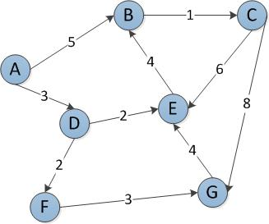
Start Node: A
Goal Node: G
Step Frontier Expand[*] Explored: a set of nodes
1 {(A,0)} A ∅
2 {(A-D,3),(A-B,5)} D {A}
3 {(A-B,5),(A-D-E,5),(A-D-F,5)} B {A,D}
4 {(A-D-E,5),(A-D-F,5),(A-B-C,6)} E {A,D,B}
5 {(A-D-F,5),(A-B-C,6)}[*] F {A,D,B,E}
6 {(A-B-C,6),(A-D-F-G,8)} C {A,D,B,E,F}
7 (A-D-F-G,8)} G {A,D,B,E,F,C}
8 ∅
Found the path: A -> D -> F -> G.
*B is not added to the frontier because it is found in the explored set.

Slide 154
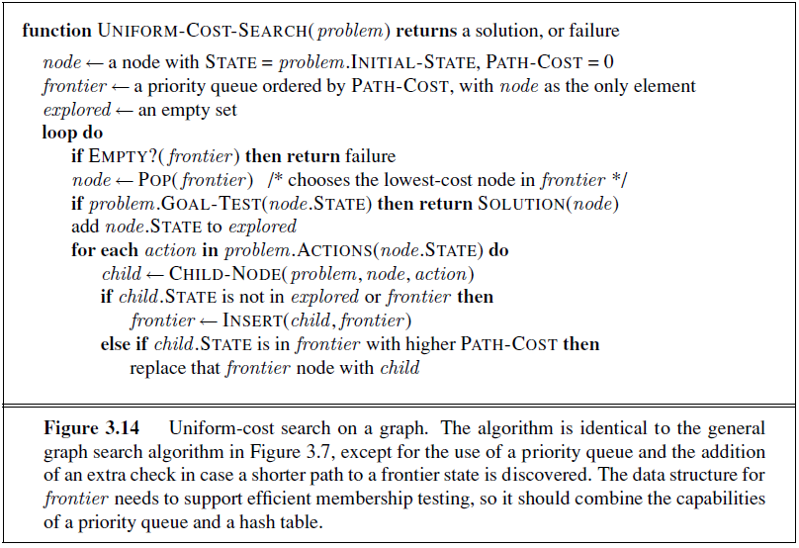
Uniform Cost Search

Slide 155
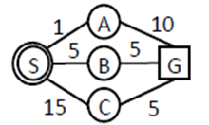
Uniform Cost Search

Slide 156

Uniform Cost Search

Slide 157

Uniform Cost Search
The graph above shows the step-costs for different paths going from the start (S) to the goal (G).
Use uniform cost search to find the optimal path to the goal.

Slide 158
 | Frontier | Expand | Explored
1 | S | S | Empty

Slide 159
 | Frontier | Expand | Explored
1 | S | S | Empty
2 | (S-C,1) (S-B,2)(S-A,3) | C | S

Slide 160
 | Frontier | Expand | Explored
1 | S | S | Empty
2 | (S-C,1) (S-B,2)(S-A,3) | C | S
3 | (S-B,2)(S-A,3)(S-C-G,21) | B | S,C

Slide 161
 | Frontier | Expand | Explored
1 | S | S | Empty
2 | (S-C,1) (S-B,2)(S-A,3) | C | S
3 | (S-B,2)(S-A,3)(S-C-G,21) | B | S,C
4 | (S-A,3)(S-C-G,21)(S-B-E,6) | A | S,C,B

Slide 162
 | Frontier | Expand | Explored
1 | S | S | Empty
2 | (S-C,1) (S-B,2)(S-A,3) | C | S
3 | (S-B,2)(S-A,3)(S-C-G,21) | B | S,C
4 | (S-A,3)(S-C-G,21)(S-B-E,6) | A | S,C,B
5 | (S-C-G,21)(S-B-E,6)(S-A-D,9) | E | S,C,B,A

Slide 163
 | Frontier | Expand | Explored
1 | S | S | Empty
2 | (S-C,1) (S-B,2)(S-A,3) | C | S
3 | (S-B,2)(S-A,3)(S-C-G,21) | B | S,C
4 | (S-A,3)(S-C-G,21)(S-B-E,6) | A | S,C,B
5 | (S-C-G,21)(S-B-E,6)(S-A-D,9) | E | S,C,B,A
6 | (S-C-G,21) (S-A-D,9) (S-B-E-G,14) | D | S,C,B,A,E

Slide 164
 | Frontier | Expand | Explored
1 | S | S | Empty
2 | (S-C,1) (S-B,2)(S-A,3) | C | S
3 | (S-B,2)(S-A,3)(S-C-G,21) | B | S,C
4 | (S-A,3)(S-C-G,21)(S-B-E,6) | A | S,C,B
5 | (S-C-G,21)(S-B-E,6)(S-A-D,9) | E | S,C,B,A
6 | (S-C-G,21) (S-A-D,9) (S-B-E-G,14) | D | S,C,B,A,E
7 | (S-C-G,21) (S-B-E-G,14) (S-A-D-F,10) | F | S,C,B,A,E,D

Slide 165
 | Frontier | Expand | Explored
1 | S | S | Empty
2 | (S-C,1) (S-B,2)(S-A,3) | C | S
3 | (S-B,2)(S-A,3)(S-C-G,21) | B | S,C
4 | (S-A,3)(S-C-G,21)(S-B-E,6) | A | S,C,B
5 | (S-C-G,21)(S-B-E,6)(S-A-D,9) | E | S,C,B,A
6 | (S-C-G,21) (S-A-D,9) (S-B-E-G,14) | D | S,C,B,A,E
7 | (S-C-G,21) (S-B-E-G,14) (S-A-D-F,10) | F | S,C,B,A,E,D
8 | (S-C-G,21) (S-B-E-G,14) (S-A-D-F-G,11)

Slide 166
 | Frontier | Expand | Explored
1 | S | S | Empty
2 | (S-C,1) (S-B,2)(S-A,3) | C | S
3 | (S-B,2)(S-A,3)(S-C-G,21) | B | S,C
4 | (S-A,3)(S-C-G,21)(S-B-E,6) | A | S,C,B
5 | (S-C-G,21)(S-B-E,6)(S-A-D,9) | E | S,C,B,A
6 | (S-C-G,21) (S-A-D,9) (S-B-E-G,14) | D | S,C,B,A,E
7 | (S-C-G,21) (S-B-E-G,14) (S-A-D-F,10) | F | S,C,B,A,E,D
8 | (S-C-G,21) (S-B-E-G,14) (S-A-D-F-G,11)
9 | S-A-D-F-G,11 Goal Found |  | S,C,B,A,E,D,F,G

Slide 167

Traverse from start state (S) to Goal state (G)
Step | Frontier | Expand | Explored: a set of Nodes
1 | (S,0) | S | Ø

Slide 168
Traverse from start state (S) to Goal state (G)
Step | Frontier | Expand | Explored: a set of Nodes
1 | (S,0) | S | Ø
2 | (S-C,2) (S-D,2) (S-A,3) | C | S

Slide 169
Traverse from start state (S) to Goal state (G)
Step | Frontier | Expand | Explored: a set of Nodes
1 | (S,0) | S | Ø
2 | (S-C,2) (S-D,2) (S-A,3) | C | S
3 | (S-D,2) (S-A,3)(S-C-F,3) | D | S,C

Slide 170
Traverse from start state (S) to Goal state (G)
Step | Frontier | Expand | Explored: a set of Nodes
1 | (S,0) | S | Ø
2 | (S-C,2) (S-D,2) (S-A,3) | C | S
3 | (S-D,2) (S-A,3)(S-C-F,3) | D | S,C
4 | (S-A,3)(S-C-F,3)(S-D-B,5)(S-D-G,10) | A | S,C,D

Slide 171
Traverse from start state (S) to Goal state (G)
Step | Frontier | Expand | Explored: a set of Nodes
1 | (S,0) | S | Ø
2 | (S-C,2) (S-D,2) (S-A,3) | C | S
3 | (S-D,2) (S-A,3)(S-C-F,3) | D | S,C
4 | (S-A,3)(S-C-F,3)(S-D-B,5)(S-D-G,10) | A | S,C,D
5 | (S-C-F,3)(S-D-B,5)(S-D-G,10) | F | S,C,D,A

Slide 172
Traverse from start state (S) to Goal state (G)
Step | Frontier | Expand | Explored: a set of Nodes
1 | (S,0) | S | Ø
2 | (S-C,2) (S-D,2) (S-A,3) | C | S
3 | (S-D,2) (S-A,3)(S-C-F,3) | D | S,C
4 | (S-A,3)(S-C-F,3)(S-D-B,5)(S-D-G,10) | A | S,C,D
5 | (S-C-F,3)(S-D-B,5)(S-D-G,10) | F | S,C,D,A
6 | (S-D-B,5)(S-D-G,10)(S-C-F-E,3)(S-C-F-G,7) | E | S,C,D,A,F

Slide 173
Traverse from start state (S) to Goal state (G)
Step | Frontier | Expand | Explored: a set of Nodes
1 | (S,0) | S | Ø
2 | (S-C,2) (S-D,2) (S-A,3) | C | S
3 | (S-D,2) (S-A,3)(S-C-F,3) | D | S,C
4 | (S-A,3)(S-C-F,3)(S-D-B,5)(S-D-G,10) | A | S,C,D
5 | (S-C-F,3)(S-D-B,5)(S-D-G,10) | F | S,C,D,A
6 | (S-D-B,5)(S-D-G,10)(S-C-F-E,3)(S-C-F-G,7) | E | S,C,D,A,F
7 | (S-D-B,5)(S-D-G,10) (S-C-F-G,7) (S-C-F-E-G,5) | B | S,C,D,A,F,E

Slide 174
Traverse from start state (S) to Goal state (G)
Step | Frontier | Expand | Explored: a set of Nodes
1 | (S,0) | S | Ø
2 | (S-C,2) (S-D,2) (S-A,3) | C | S
3 | (S-D,2) (S-A,3)(S-C-F,3) | D | S,C
4 | (S-A,3)(S-C-F,3)(S-D-B,5)(S-D-G,10) | A | S,C,D
5 | (S-C-F,3)(S-D-B,5)(S-D-G,10) | F | S,C,D,A
6 | (S-D-B,5)(S-D-G,10)(S-C-F-E,3)(S-C-F-G,7) | E | S,C,D,A,F
7 | (S-D-B,5)(S-D-G,10) (S-C-F-G,7) (S-C-F-E-G,5) | B | S,C,D,A,F,E
8 | (S-D-G,10) (S-C-F-G,7) (S-C-F-E-G,5)(S-D-B-E,7) | G | S,C,D,A,F,E,B

Slide 175
Traverse from start state (S) to Goal state (G)
Step | Frontier | Expand | Explored: a set of Nodes
1 | (S,0) | S | Ø
2 | (S-C,2) (S-D,2) (S-A,3) | C | S
3 | (S-D,2) (S-A,3)(S-C-F,3) | D | S,C
4 | (S-A,3)(S-C-F,3)(S-D-B,5)(S-D-G,10) | A | S,C,D
5 | (S-C-F,3)(S-D-B,5)(S-D-G,10) | F | S,C,D,A
6 | (S-D-B,5)(S-D-G,10)(S-C-F-E,3)(S-C-F-G,7) | E | S,C,D,A,F
7 | (S-D-B,5)(S-D-G,10) (S-C-F-G,7) (S-C-F-E-G,5) | B | S,C,D,A,F,E
8 | (S-D-G,10) (S-C-F-G,7) (S-C-F-E-G,5)(S-D-B-E,7) | G | S,C,D,A,F,E,B
9 | (S-C-F-E-G,5) Goal Found

Slide 176
Uniform Cost Search (UCS) Properties
What nodes does UCS expand?
  Processes all nodes with cost less than cheapest solution!
  If that solution costs C* and arcs cost at least ε , then the “effective depth” is roughly C*/ε
  Takes time O(b^{C*/ε}) (exponential in effective depth)
How much space does the fringe take?
  Has roughly the last tier, so O(b^{C*/ε})
Is it complete?
  Assuming best solution has a finite cost and minimum arc cost is positive, yes!
Is it optimal?
  Yes! (Proof next lecture via A*)
b
c ≤ 1
…
C*/ε “tiers”
c ≤ 2
c ≤ 3

Slide 177
Uniform Cost Issues
…
c ≤ 1
Remember: UCS explores increasing cost contours
The good: UCS is complete and optimal!
The bad:
  Explores options in every “direction”
  No information about goal location
We’ll fix that soon!
c ≤ 2
c ≤ 3
Start
Goal

Slide 178

Bidirectional Search
Idea
  simultaneously search forward from S and backwards from G
  stop when both “meet in the middle”
  need to keep track of the intersection of 2 open sets of nodes
What does searching backwards from G mean
  need a way to specify the predecessors of G
  this can be difficult,
  e.g., predecessors of checkmate in chess?
what if there are multiple goal states?
  what if there is only a goal test, no explicit list?
Complexity
  Time complexity is best: $O\left(2b^{\left(d/2\right)}\right)=O\left(b^{\left(d/2\right)}\right)$
  memory complexity is the same

Slide 179

Bidirectional Search

Slide 180

Summary of Algorithms
b branching factor
d depth of the shallowest solution
m maximum depth of the search tree
l depth limit
Superscripts:
a complete if b is finite
b complete if step costs ≥ epsilon for +ve epsilon
c optimal if step costs are all identical
180

Slide 181

Summary of Algorithms

